Slide 1
Game Development COMP3064
Week 6

Slide 2
This week
More physics
Materials
Line Casting
Review

Slide 3
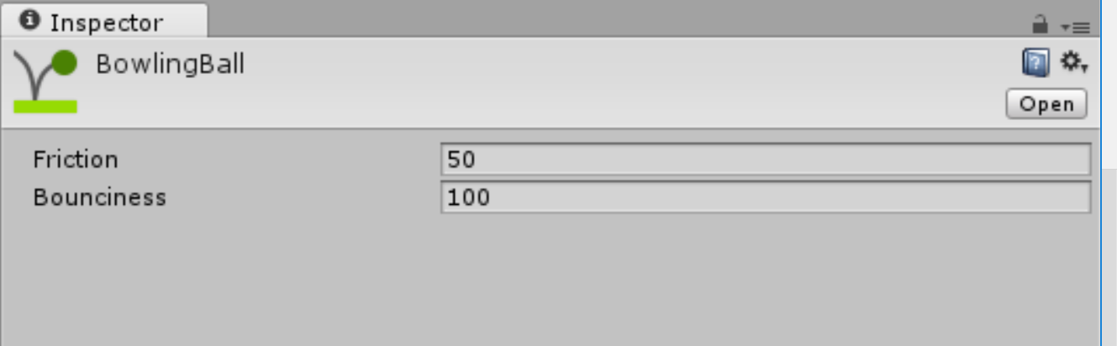
Physics Material (2D)
Physics material describes how to handle colliding objects
Friction
Bounciness
Variables
bounciness | The degree of elasticity during collisions.
friction | Coefficient of friction.

Slide 4
Physics Material (2D)
Simple configuration
How much friction?
How bouncy should it be?

Slide 5
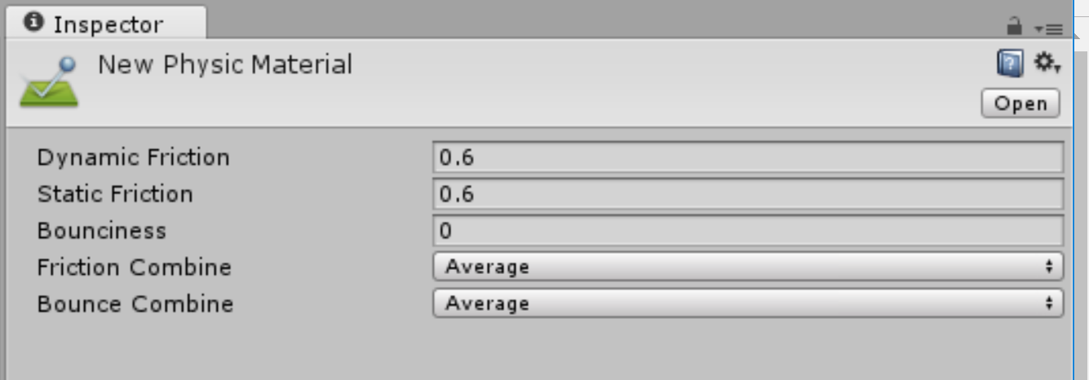
Physic Material (3D)
Physics material describes how to handle colliding objects
Friction
Bounciness
Variables
bounceCombine | Determines how the bounciness is combined.
bounciness | How bouncy is the surface? A value of 0 will not bounce. A value of 1 will bounce without any loss of energy.
dynamicFriction | The friction used when already moving. This value has to be between 0 and 1.
frictionCombine | Determines how the friction is combined.
staticFriction | The friction coefficient used when an object is lying on a surface.

Slide 6
Physic Material (3D)

Slide 7
PhysicMaterialCombine
Static variables
Average | Averages the friction/bounce of the two colliding materials.
Minimum | Uses the smaller friction/bounce of the two colliding materials.
Multiply | Multiplies the friction/bounce of the two colliding materials.
Maximum | Uses the larger friction/bounce of the two colliding materials.

Slide 8
Line Casting

Slide 9
How would you detect objects in your sight?

Slide 10
Line casting
RaycastHit2D Linecast( Vector2 start, Vector2 end,
int layerMask = DefaultRaycastLayers,
float minDepth = -Mathf.Infinity,
float maxDepth = Mathf.Infinity);
start The start point of the line in world space.
end The end point of the line in world space.
layerMask Filter to detect Colliders only on certain layers.
minDepth Only include objects with a Z coordinate (depth) greater than or equal to this value.
maxDepth Only include objects with a Z coordinate (depth) less than or equal to this value.

Slide 11
Where will we use it?
Detecting enemies
Shooting (if your bullets are tiny, don’t draw it, use line casing)
Following player
Detecting if player is grounded

Slide 12
Review
Mid-term is next week (week 7)

Slide 13
Creating and Opening a project
For the mid-term, you’d have to open given project.
Tips:
If you work with different version of Unity make sure that all resources are loaded and sprites have the material loaded!

Slide 14
Managing assets
Import
Set proper point/unit ratio

Slide 15
Creating prefabs
Configure and store
Use drag-and-drop action
Keep it organized!

Slide 16
Scripting
Naming!!!!!!!!!
Use CamelCase naming convention
Make sure that name of the class and file are the same! (otherwise Unity won’t like your script)
Know your methods:
Start/Awake/Update/FixedUpdate
OnCollision…….2D/ OnTrigger……2D

Slide 17
Moving things
Input
GetKey vs. GetAxis
Transform
Rotation
Position
Scale

Slide 18
Physics
Required components
RigidBody2D
Collider2D
Trigger or not
Kinematic or not

Slide 19
Audio
Import
AudioListener
AudioSource

Slide 20
More scripting and UI
Singleton!!!
Building HUD and counting points/health

Slide 21
Questions?

